Slide 1
Behavioral Health Services & Opioid Risk
Management
Suzie Matsuda, PsyD
Clinical Director, Behavioral Health Services
smatsuda@lacare.org
Clayton Chau, MD
Medical Director, Behavioral Health Services
cchau@lacare.org

Slide 2
Goals
Understand the new behavioral health benefits
Medi-Cal Behavioral Health System of care in LA county
Screening, Brief Intervention and Referral to Treatment
Referral process – the Screening Tool

Slide 3
Understanding the
New Behavioral Health Benefits

Slide 4
What is Behavioral Health?
Behavioral Health = Mental Health Services and Substance Use Disorder Services

Slide 5
Expanded Mental Health Services
    Started January 1, 2014, Medi-Cal managed care is now responsible for providing Medi-Cal members with the following mental health benefits:
        Individual and group mental health evaluation and treatment (psychotherapy);
        Psychological testing when clinically indicated to evaluate a mental health condition;
        Outpatient services for the purposes of monitoring medication treatment;
        Outpatient laboratory, medications, supplies and supplements (supplements may include vitamins that are not specifically excluded in the Medi-Cal formulary and that are scientifically proven effective in the treatment of mental health disorders (although none are currently indicated for this purpose)) ;
        Psychiatric consultation;
        PCP screening and brief intervention to identify, reduce and prevent problematic alcohol use.
No change in specialty mental health services, which will continue to be provided by LA County Department of Mental Heath (DMH)

Slide 6
Expanded Substance Use
Disorder Services
New services provided by DPH
        Intensive Outpatient Treatment
          This service is now available for the general population
        Voluntary Inpatient Medical Detoxification
          This service is now available to the general population (Medi-Cal fee-for-service)
        Residential Substance Use Disorder Services
          This service is still only available for pregnant and postpartum women
          Will possibly be expanded for the general population

Slide 7
Medi-Cal Behavioral Health
System of Care in LA County
*Behavioral Health = Mental Health Services and
Substance Use Disorder Services

Slide 8
Behavioral Health in Medi-Cal 2014

Slide 9
LA Care Medi-Cal
Mental Health Services
  New services provided by Beacon’s network of providers: (services that are medically necessary to protect life, prevent significant illness or significant disability, or to alleviate severe pain through the diagnosis and treatment of disease, illness, or injury)
        Individual/group mental health evaluation and treatment (psychotherapy)
        Psychological testing when clinically indicated to evaluate a mental health condition
        Psychiatric consultation to PCPs for medication management
        Outpatient services for the purposes of monitoring medication treatment
        Outpatient laboratory, supplies and supplements (supplements may include vitamins that are not specifically excluded in the Medi-Cal formulary and that are scientifically proven effective in the treatment of mental health disorders (although none are currently indicated for this purpose))
  *Included diagnosis – a mental health disorder as defined by the current Diagnostic & Statistical Manual (DSM).
  * Not covered – conditions that the DSM identifies as relational problems. Hence, couple and family counseling are not covered services.

Slide 10
LA County DMH Medi-Cal Specialty
Mental Health Services (SMHS)
  Services provided by LA County Department of Mental Health:
        Inpatient services
        Residential services
        Outpatient services
  To be eligible for services, beneficiaries must meet three criteria:
        SMHS Included diagnosis
        Significant functional Impairment or probability of significant deterioration
        Condition would be responsive to mental health services and not physical health care treatments

Slide 11
Medi-Cal SMHS Included Diagnoses
Medi-Cal SMHS Included Diagnoses
Pervasive Developmental Disorders except Autism Spectrum Disorder | Schizophrenia & other Psychotic Disorders | Dissociative Disorders | Adjustment Disorders
Attention Deficit/Hyperactivity Disorders | Mood Disorders | Paraphilic Disorders | Personality Disorders excluding Antisocial Personality Disorders
Feeding & Eating Disorders of Infancy or Early Childhood | Anxiety Disorders | Gender Dysphoria | Medication - Included Movement Disorders
Elimination Disorders | Somatic Symptom & Related Disorders | Eating Disorders
Other Disorders of Infancy, Childhood or Adolescence | Factitious Disorders | Disruptive, Impulse-control Disorders and Conduct Disorders

Slide 12
SAPC Drug Medi-Cal SUD Services
Outpatient services
        Outpatient drug free treatment
        Intensive outpatient treatment (newly expanded to all populations)
        Narcotic treatment services - methadone maintenance
        Naltrexone for opioid dependence (a Medi-Cal benefit through fee-for-service, outside of Drug Medi-Cal)
Inpatient services
        Voluntary Inpatient Detoxification Services (newly expanded with NO restriction of physical medical necessity)
      Residential Substance Use Disorder Services
        This service is still only available for pregnant and postpartum women
        Will possibly be expanded for the general population

Slide 13
Screening, Brief Intervention
& Referral to Treatment
(SBIRT)

Slide 14
Requirements
SBIRT services must be provided by a licensed health care provider (PCP/PA/NP/Psychologist) or a non-licensed staff working under the supervision of the licensed health care provider
Non-licensed staff must be trained in SBIRT services in order to provide services
The supervising licensed provider and the non-licensed providers of SBIRT services must attest that they have obtained the required trainings on SBIRT within the first 12 months. The training is a one-time requirement
The reporting and monitoring requirements will follow as per DHCS

Slide 15
Process
Pre-screen
(Expanded) Screening
Brief intervention: One to three 15-minute sessions
Referral to Treatment: the Department of Public Health/Substance Abuse Prevention & Control program

Slide 16
Pre-Screen
A single alcohol screening question included in the Staying Healthy Assessment (SHA) which must be conducted within 120 days of enrollment and every three years with annual reviews of the member’s answer
In the past year, have you had:
        (men) 5 or more alcohol drinks in one day?
        (women) 4 or more alcohol drinks in one day?

Slide 17
Screen
Screen members 18 years of age and older who answer “yes” to the alcohol question in the SHA or at any time the PCP identifies a potential alcohol misuse problem.
Recommended screening tool – the Alcohol Use Disorders Identification Test (AUDIT) or the Alcohol Use Disorder Identification Test—Consumption (AUDIT-C) developed by the World Health Organization (WHO) as a simple method of screening for excessive drinking and to assist in brief assessment

Slide 18
Standard Drink in the US
1 standard drink = 14 grams of pure alcohol (about 0.6 fluid ounces or 1.2 tablespoons)
Standard drink equivalent:
        Beer: 12 oz = 1 22 oz = 2
        16 oz = 1.3 40 oz = 3.3
        Table wine: a 5 oz glass = 1
        a standard 750 ml (25 oz) bottle = 5
        Malt liquor: 12 oz = 1.5 22 oz = 2.5
        16 oz = 2 40 oz = 4.5
        Hard liquor or ‘80-proof spirits’:
        a pint (16 oz) = 11
        a fifth (25 oz) = 17
        1.75 L (59 oz) = 39

Slide 19
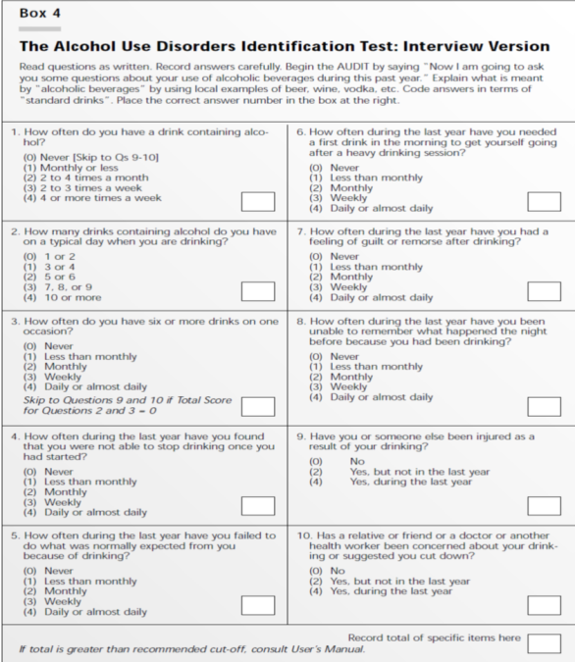
The AUDIT
Tool

Slide 20
AUDIT Scores
*Continue monitoring with each intervention
Risk Level | AUDIT Score | Intervention
Zone I | 0-7 | Alcohol Education
Zone II | 8-15 | Simple Advice
Zone III | 16-19 | Brief Intervention
Zone IV | 20-40 | Referral to Treatment

Slide 21
Brief Intervention
Members screened positively for risky or hazardous alcohol use or a potential alcohol use disorder (Zone III) shall be offered up to three 15-minute brief interventions (per member per year)
Each intervention is limited to one (1) session per unit, 15 minutes per unit, per member
Brief intervention services may be provided on the same date of service as the expanded screen, or on subsequent days
Each intervention can be offered in-person or via telephone or telehealth modalities

Slide 22
Referral to Treatment
Members should be referred to the Department of Public Health/SAPC for Drug Medi-Cal SUD services if they:
        Didn’t respond to the brief interventions; or
        Were screened positively for possible alcohol use disorder (Zone IV); or
        Whose diagnosis is uncertain

Slide 23
Training Requirements for Licensed Providers
At least one supervising licensed provider per clinic or practice must take 4 hours of
SBIRT training within 12 months after initiating SBIRT services
*Beyond the first 12 months of providing SBIRT services, at least one supervising
licensed provider per clinic or practice must have completed training
At all times, rendering licensed providers are highly encouraged, but not required,
to take training in order to provide the services
A minimum of 4 hours of SBIRT training is highly encouraged for both supervising
and rendering licensed providers within the first 12 months; however, the rendering
licensed providers are not required to take the training in order to provide the services
For solo physician practices, the physician is highly encouraged, but not required,
to take the training within the first 12 months.

Slide 24
Training Requirements for Non-licensed Providers
Trained non-licensed providers: Includes health educators, certified addiction counselors,
health coaches, medical assistants, and non-licensed behavioral health assistants
Requirements:
Be under the supervision of a licensed provider
Complete a minimum of 60 documented hours of professional experience such
as coursework, internship, practicum, education or professional work within their
respective field.
Should include 4 hours of training directly related to SBIRT services
such as Motivational Interviewing
Complete a minimum of 30 documented hours of face-to-face client contact
Within his or her respective field, in addition to the 60 hours of clinical professional
experience described above.
These contact hours may include internship, on-the-job
training, or professional experience and SBIRT services training.

Slide 25
SBIRT Training
SAMHSA funded – Addiction Technology Transfer Center Network: “Foundations of SBIRT” at http://www.attcelearn.org/
NIAAA Clinician’s Guide Online Training “Video Cases: Helping Patients Who Drink Too Much” at http://www.niaaa.nih.gov/publications/clinical-guides-and-manuals/niaaa-clinicians-guide-online-training
SBIRT Core Training Program: Screening, Brief Interventions, and Referral to Treatment at http://www.sbirttraining.com/sbirtcore
NAADAC’s The Addiction Professional’s Mini-Guide to Screening, Brief Intervention and Referral to Treatment (SBIRT) at http://www.naadac.org/theaddictionprofessionalsminiguidetosbirt
SBIRT Oregon Training Curriculum for Primary Care at http://sbirtoregon.org/training.php
Institute for Research, Education & Training in Addictions – SBIRT in Action – Another Vital Sign at http://ireta.org/webinarlibrary
New York State’s SBIRT Training Provider Certification at http://www.oasas.ny.gov/workforce/training/SBIRTCert.cfm
*Other trainings resources can be found on DHCS website at www.dhcs.ca.gov

Slide 26
Opioid Risk Management
Pilot Study

Slide 27
L.A. Care Pilot Study
The Association for Community Affiliated Plans’ Prescription Substance Abuse Collaborative
Given the rise in national opioid abuse and opioid related death, LA Care Health Plan proposed and Early Intervention Initiative. Pilot focusing on individuals being prescribed opiates as a part of pain management for non-cancer related conditions
Project Description: Prevention and early intervention in potential opioid misuse in non-cancer patients at selected pilot site
Goals: Implement Opioid Risk Assessment at PCP setting, SBIRT, Referral to Substance Abuse Treatment

Slide 28
Screening Tools
The Screener and Opioid Assessment for Patients with Pain (SOAPP) is a brief paper and pencil tool to facilitate assessment and planning for chronic pain patients being considered for long-term opioid treatment
The Current Opioid Misuse Measure (COMM) will help clinicians identify whether a patient, currently on long-term opioid therapy, may be exhibiting aberrant behaviors associated with misuse of opioid medications
English and Spanish versions of the SOAPP and COMM are available on the website https://www.painedu.org/index.asp

Slide 29
Pharmacy Lock-in Programs
A majority of participating plans (16 of 24) use a lock-in
program
  Several are state-run programs (WA,TX, WI)
Many lock-in patients are then referred to some type
of case management and treatment options
Multi-disciplinary teams, PBMs (Pharmacy Benefits
Management), involved in identification and follow-up work
L.A. Care has proposed a Lock-in program, awaiting State
approval

Slide 30
Issue – Effective Lock-in Programs
Lock in should be only one step in process
  Interdisciplinary team meetings
    Includes referral for substance abuse treatment and
    behavioral health assessment, as appropriate
  Specialized care management
    Includes member education and counseling
  (Use of health advocates and community outreach Pain
  management)
    Referral, assessment, and patient contracts
  Data analytics and data sharing (plan, PCP, prescriber,
  pharmacy)

Slide 31
Medication Assisted Treatment
Plans support use of MAT
Limitation on suboxone prescribers, in-network vs
private state direct contract???
  Many refuse to participate in Medicaid plan network
  Unlike other services, often operate on a cash basis
State is responsible for pharmacy benefit in Medi-Cal

Slide 32
Referral Process – the Screening Tool

Slide 33
Background
DHCS requires a clear process for referral to different level of behavioral health care between Managed Care mental health services, County specialty mental health services, and County Drug Medi-Cal services
Collaboration between LA Care, DMH, DPH/SAPC, Beacon and HealthNet
Referral to SMHP for emergency or routine services can be made directly as noted on the ACCESS grid (Provider website)
Referral for a more complete assessment for appropriate treatment may be made based on screening form algorithm
This simple screening form also accesses expedited SMHP urgent appointments, and can be used by clinician at any point of service to Member, who will not be rescreened once referred

Slide 34
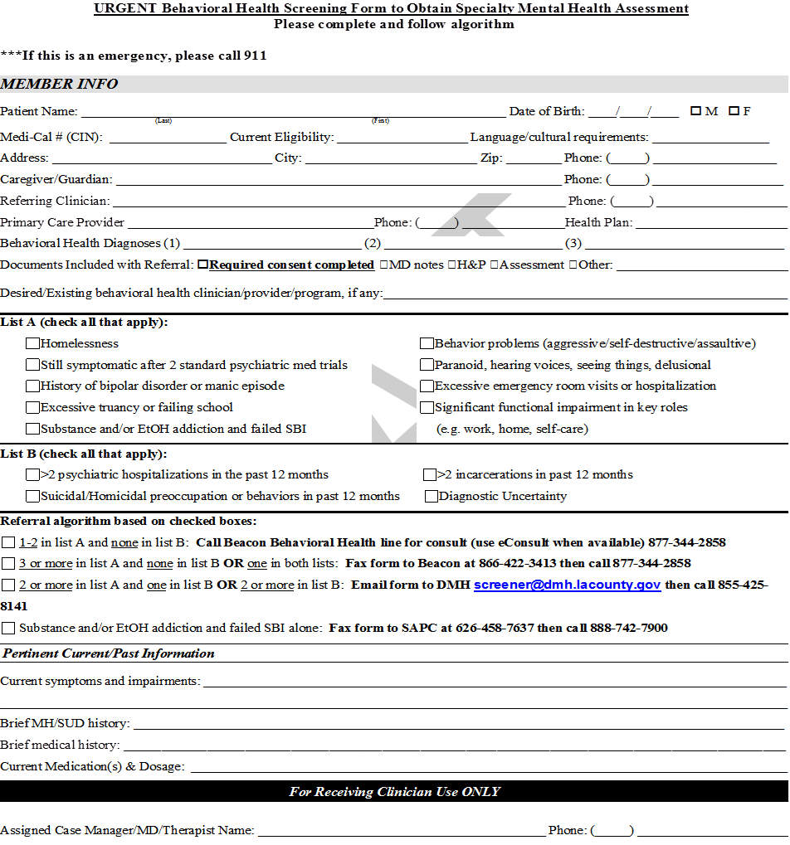
L.A. Care
Screening Form

Slide 35
The Check Lists

Slide 36
The Algorithm

Slide 37
The Instruction

Slide 38
L.A. Care Behavioral Health Contacts
        Leilanie Mercurio, Health Services Coordinator, 213-694-1250 x4456, lmercurio@lacare.org
        Clayton Chau, Medical Director, cchau@lacare.org
        Suzie Matsuda, Director of Clinical Services, smatsuda@lacare.org
        Nicole Lehman, Director of Operations, nlehman@lacare.org
        Anthony Perera, Health Data Analysis Manager, aperera@lacare.org
        Robert (RJ) Key, Program Manager, rkey@lacare.org
        Torhon Barnes, Care Coordination Manager, tbarnes@lacare.org
        Hieu Nguyen, Strategic Initiatives Manager, hnguyen@lacare.org

Slide 39
Summary
LA Care/Beacon behavioral health services access line is 877-344-2858
Ensure proper training for the SBIRT
Ensure referral process for behavioral health spectrum of care is seamless – “No Wrong Door”
We will follow up with feedback and survey to the process as well as the screening tool
eConsult/eManagement is in the development
Available Behavioral Health section on the LA Care Provider website http://www.lacare.org/providers/behavioralhealth
Future DHCS/UCLA/LA Care sponsored CME SBIRT trainings

